Slide 1

Insurance Cost Prediction
A Machine Learning project that predicts medical insurance charges using customer demographic and health-related data — helping insurers estimate costs more efficiently.

Slide 2

Project Aim
The goal is to build a Machine Learning model that can accurately predict medical insurance charges using customer demographic and health-related information.
By leveraging features such as age, BMI, smoking habits, number of children, gender, and region, the model aims to help insurance companies estimate customer insurance costs more efficiently.

Slide 3

Dataset Features
The model uses seven key features — six input variables and one target variable — to predict insurance charges.
Age
Gender
BMI
Children
Smoker
Region
Insurance Charges
Target Variable

Slide 4
Project Workflow
The project follows an eight-step pipeline from raw data to model comparison, ensuring a systematic approach to building and evaluating the prediction model.
01
02
Data Collection & Loading
Data Cleaning & Duplicate Removal
03
04
Exploratory Data Analysis (EDA)
Feature Encoding (One-Hot)
05
06
Train-Test Split
Model Training
07
08
Model Evaluation
Model Comparison
MAE, MSE, RMSE, and R^2 Score

Slide 5

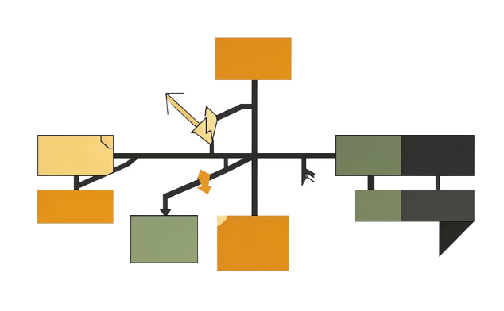

Machine Learning Models Used
Three regression algorithms were trained and compared to determine which best predicts insurance charges.
Linear Regression
Decision Tree Regressor
Random Forest Regressor
Establishes a baseline by modeling a linear relationship between features and insurance charges.
Splits data based on feature values to capture non-linear patterns in insurance cost prediction.
Combines multiple decision trees to improve prediction accuracy and reduce overfitting.

Slide 6
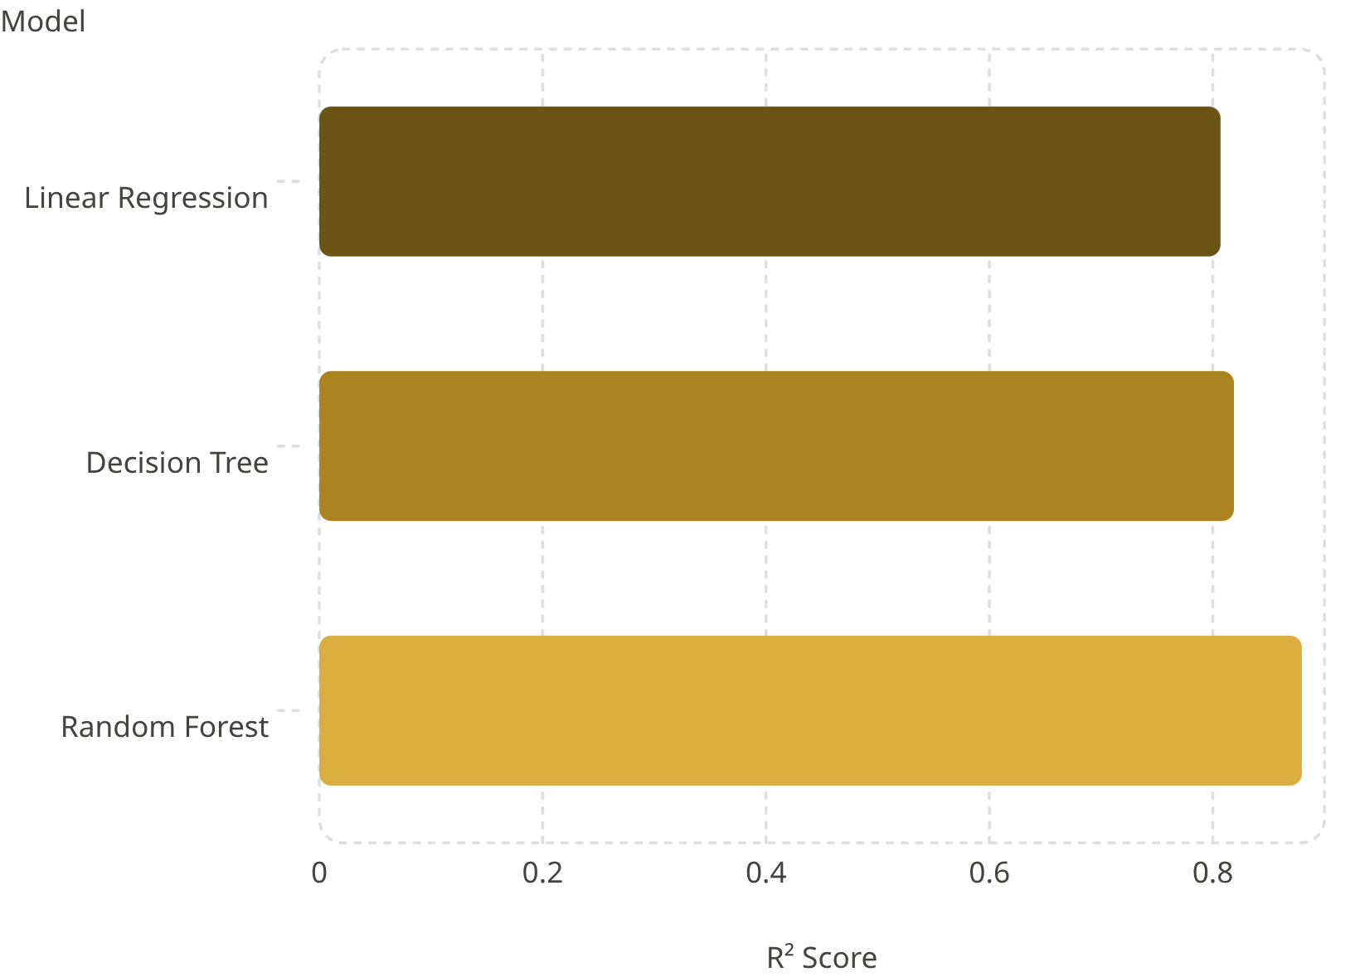
Model Performance Comparison
Key Metric: R² Score
R² Score measures how well the model explains variance in insurance charges — the closer to 1.0, the better the fit.
Linear Regression: 0.8069
Decision Tree Regressor: 0.8189
Random Forest Regressor: 0.8797 ⭐
All models were also evaluated using MAE, MSE, and RMSE to assess prediction error.

Slide 7

Best Model: Random Forest Regressor
0.8797
3
R² Score
Models Compared
Highest among all three models tested
Linear, Decision Tree, Random Forest
7
Features Used
Age, BMI, smoker, children, gender, region

Slide 8

Conclusion
The project successfully predicted medical insurance charges using Machine Learning techniques. Among all models, the Random Forest Regressor performed best with the highest R² Score of 0.8797, indicating strong prediction accuracy.
The project demonstrates how Machine Learning can help insurance companies estimate customer insurance costs more efficiently. By applying a structured workflow — from data cleaning and EDA to feature encoding, model training, and evaluation — the project showcases a complete end-to-end ML pipeline for insurance cost prediction.

Slide 9
Future Improvements
Larger Real-World Datasets
Advanced Boosting Algorithms
Expand data volume and diversity for more robust, generalizable predictions.
Apply XGBoost and similar techniques to further improve model accuracy.
Model Deployment
Web Application Integration
Deploy the model using Flask or Streamlit for real-time predictions.
Integrate the trained model into web applications for broader accessibility.

Slide 10

Key Takeaways
🎯 Clear Objective
Predict insurance charges using demographic and health features.
⚙️ Structured Pipeline
8-step workflow from data loading to model comparison.
🏆 Best Model
Random Forest achieved R² = 0.8797 — the strongest performer.
🚀 What's Next
XGBoost, deployment, and real-world scaling on the roadmap.

